Slide 1
Sets project presentation
Dylan Soemitro, Mujie Wang, Xiaorong Wang

Slide 2
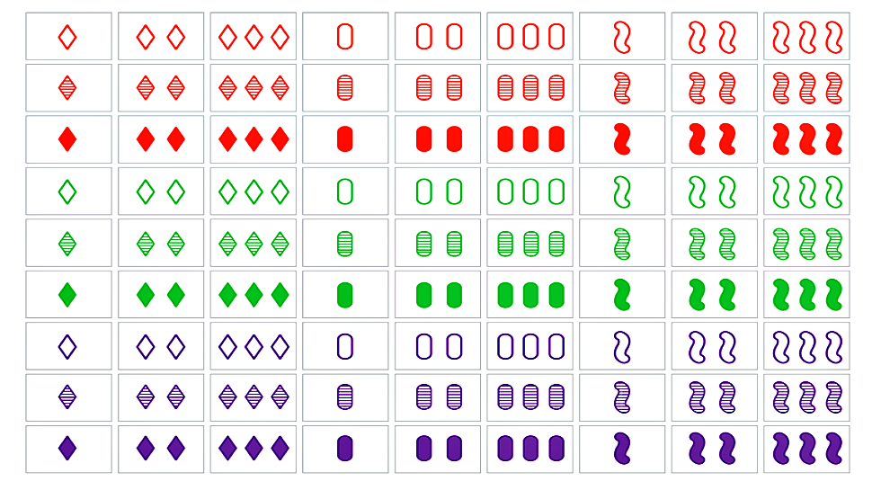
https://geekandsundry.com/the-card-game-that-puzzled-mathematicians-for-decades/
Notes:
Set is a puzzle game with 81 different cards. Each card has four attributes: number, color, shade, and shape. Each attribute has three categories (see table below). Three cards are a “set” if and only if for each attribute, they either all fall into the same category (e.g. they are all green), or they all fall into different categories.

Slide 3
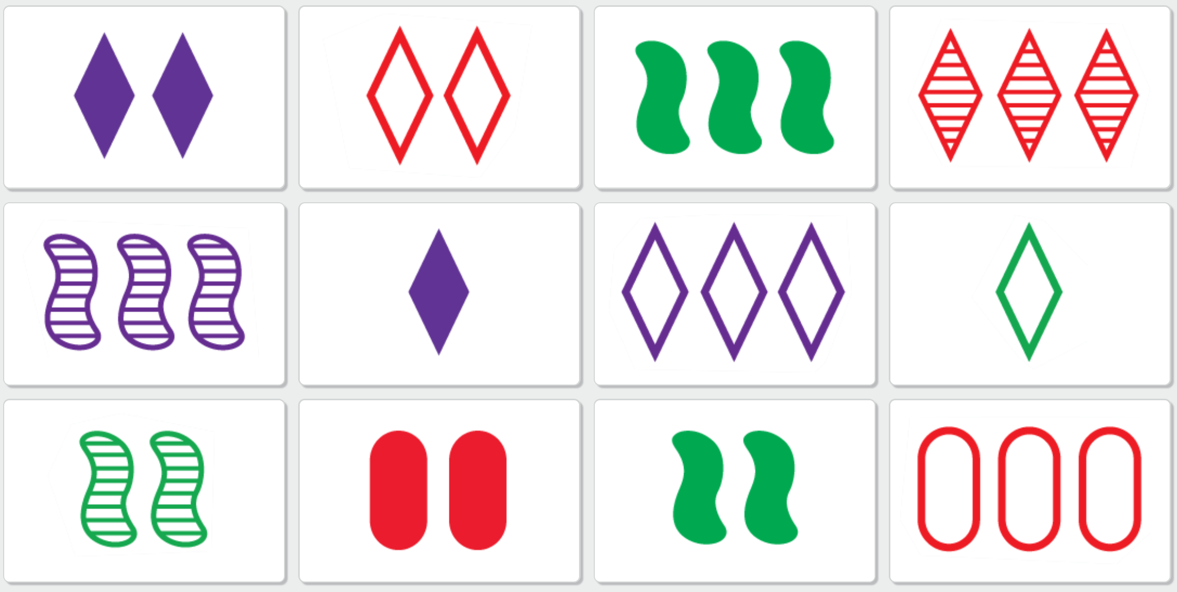
What defines a set?
Must satisfy all of these conditions
They all have the same number or have three different numbers.
They all have the same shape or have three different shapes.
They all have the same shading or have three different shadings.
They all have the same color or have three different colors.
Notes:
Must satisfy all of these conditions
They all have the same number or have three different numbers.
They all have the same shape or have three different shapes.
They all have the same shading or have three different shadings.
They all have the same color or have three different colors.

Slide 4
Program logic/process
We will generate a set of cards of user-defined size (E.g. 3*4). Each card will resemble the ones in the game “Sets” with distinct features. (There will be more user defined parts such as choosing the difficulty depending on the size)
Based on the cards and the patterns on the card that we have generated, we will be using a graph-like data structure to store all of the available ‘sets’. It is “graph-like” as for each edge in the graph, it contains three nodes, as opposed to in normal graph each edge contains 2 nodes.
We will be using Pygame modules to display the game. Specifically, we will highlight the card that we want to hint the player.

Slide 5
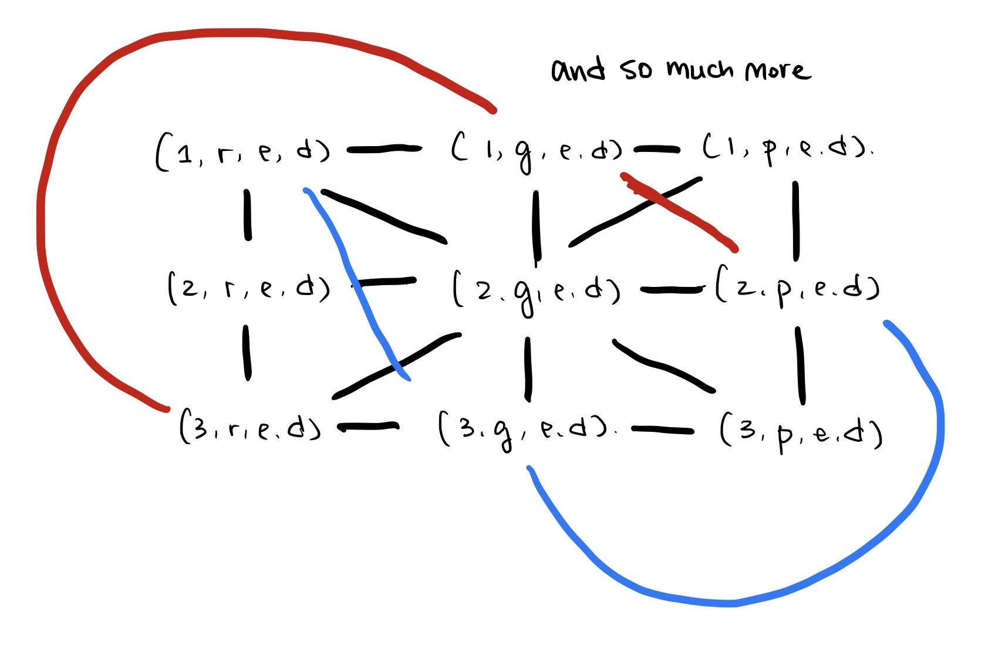
Data Structure
A graph-based data structure.
Each edge contains three nodes, as opposed to in normal graph each edge contains 2 nodes.

Slide 6
Timeline
Nov.18 - Nov.21 Proposal and general idea of the project
Nov.22 - Nov.26 Finish the establishment of the graph before thanksgiving.
Nov.27 - Dec. 6 Individually working on 1. The generation of sets of cards (definition) 2. Two of us will be working together on the implementation of the game and to deal with the different choices of user choices
Dec.7 - Dec.9 Prepare for final presentation

Slide 7
Risks
The creation of the matrix might be too slow to finish in 60 seconds where we are suppose to give hints.
This is a game that many people have already developed and many similar things are available on the Internet.
The use of pygames as a completely new package

